Slide 1


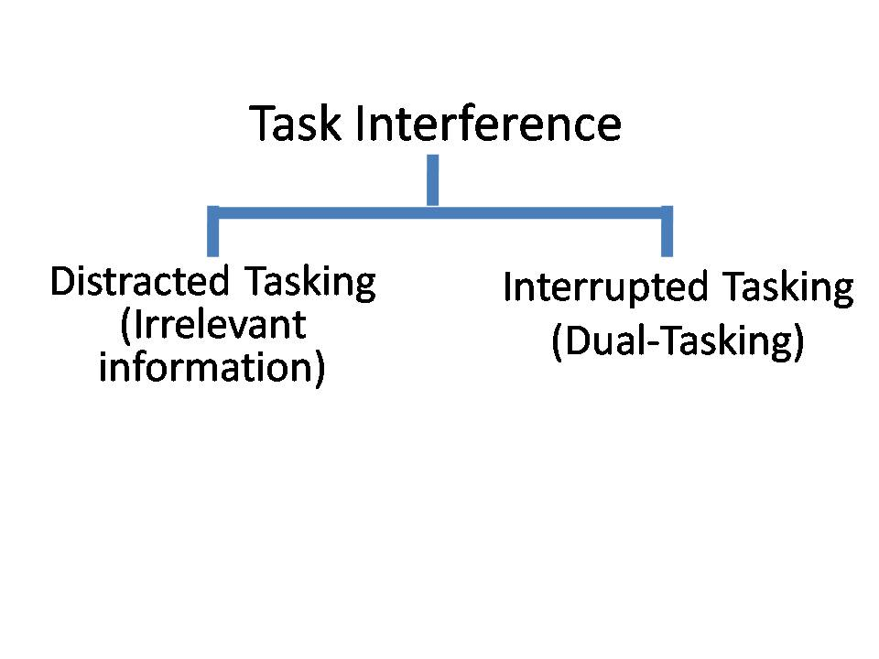
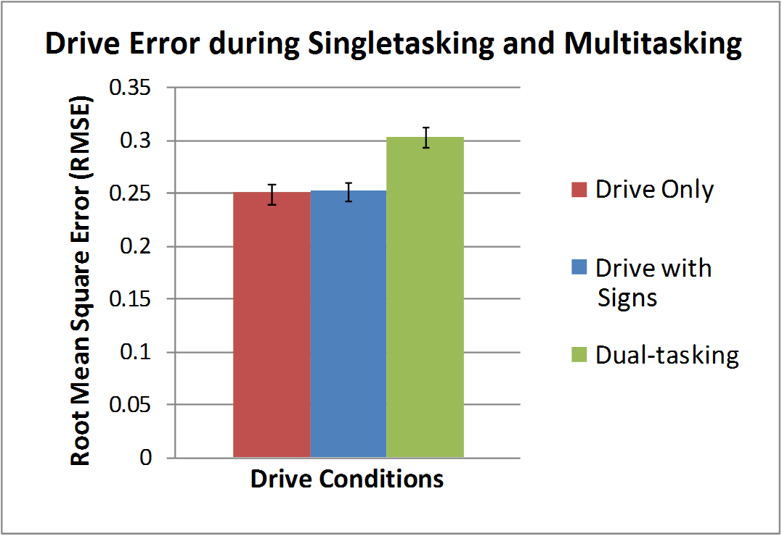
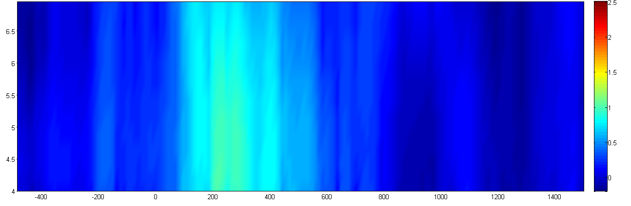
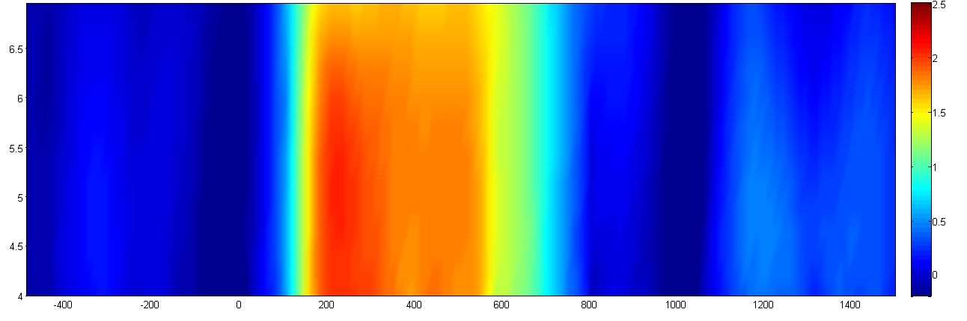
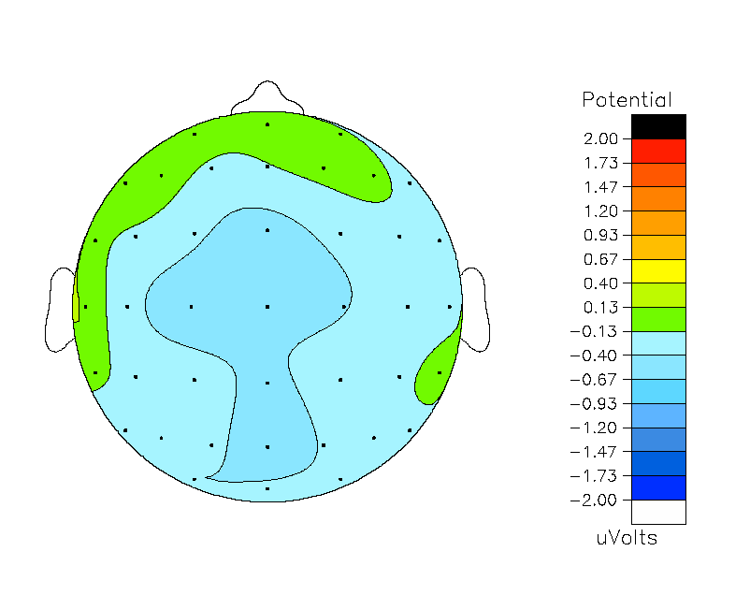
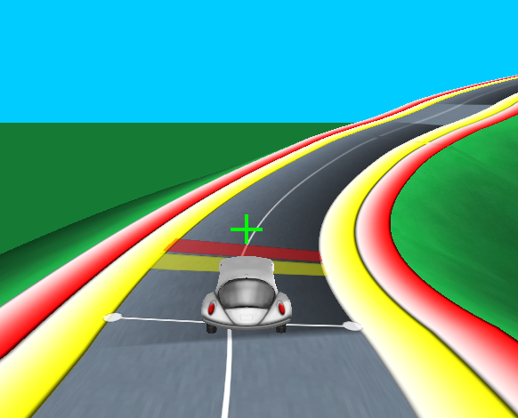
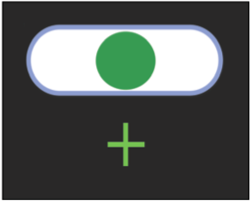
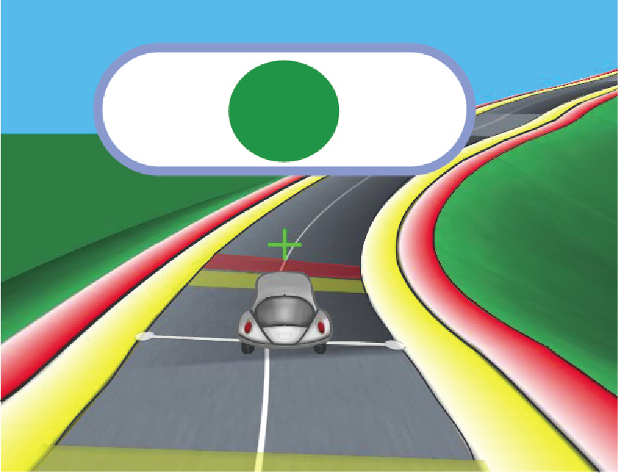
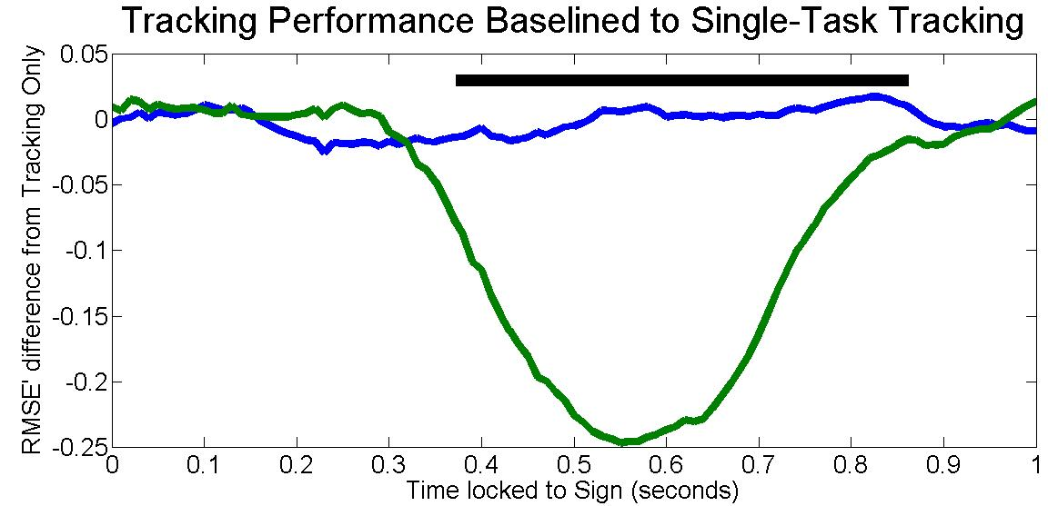
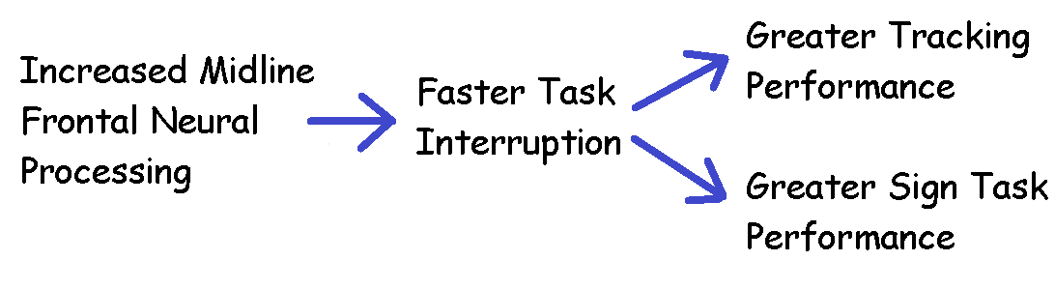
Efficient Task Switching Underlies Optimal Multitasking Performance
Omar AlHashimi, MD, PhD^{1,2}, Anguera, Joaquin, PhD³, Zanto, Theodore, PhD³ and Adam Gazzaley MD, PhD^{2,3,4} ¹Department of Psychology, UCLA ²Department of Bioengineering UCSF/UCB, Neurology UCSF, ³Departments of Neurology and Physiology, UCSF, ⁴Department of Psychiatry, UCSF
INTRO/METHODS
Task interference has been previously
characterized as distraction and
interruption, two neurobehaviorally
distinct mechanisms (Clapp & Gazzaley, 2010).
We use NeuroRacer (Anguera, et al., 2013), a paradigm previously used to characterize cognitive control ability during multitasking interference as well as its neural correlates [specifically, increased midline frontal theta power following practice-based training].
NeuroRacer uses complex continuous tracking task in conjunction with a simple discrimination task (with EEG recording) to determine the neural mechanisms of interruption during dual-tasking.
Using EEG and a high resolution tracking paradigm (NeuroRacer), we report on the individual differences in multitasking performance.
BEHAVIORAL RESULTS
Figure 1 Impact of multitasking interference on tracking performance and sign performance
Tracking performance measured as Root Mean Square Error (idealized distance from center of road in two dimensions where perfect tracking would be zero).
Road performance is worse when dual-tasking versus distraction (p = 2.4e-6) and worse when dual-tasking versus tracking alone (p=7.3e-7).
Tracking with Signs did not differ in road performance from tracking alone (p = 0.71) thus demonstrating this perceptually-matched condition as an appropriate comparison condition.
Figure 2 Timing of Interruption of Tracking Task by Sign Task
Dual-Task Tracking (Green) < Tracking with Signs (Blue)
Continuous tracking performance was measured as RMSE (root mean square) from the ideal path on the road)
RMSE of Distracted Tracking (blue) and Dual-Tasking (green) conditions were baselined against participant’s individualized RMSE waveform of their Tracking Only performance
condition to examine the differential effect of interruption:
Interruption of tracking occurs ~300 ms after sign onset (as an onset of a negative slope in baselined RMSE, 5% above baseline).
Correction occurs after sign response (495 ms + 10 ms) as an onset of positive slope occuring around ~550 ms.
Tracking RMSE returns to baseline (is equivalent to distracted tracking) by ~850 ms.
NEURAL RESULTS
Figure 3 Peak Midline Frontal Theta Activity by Goal
Midline frontal theta modulated by goals;
conditions perceptually matched;
Dual task (bottom) vs Tracking w/ Signs (top)
Figure 4 Goal-related interference on midline frontal neural activity
t(_{1,19})= 3.82; p = 0.001
Dual-Task Tracking and Discrimination vs Tracking with Signs
Peak midline frontal theta activity to signs during sign response (windowed from 200 to 600 ms after sign presentation) is increased by an active tracking task (dual-tasking) when compared to the perceptually-matched distraction condition.
Frontal theta power is increased in the dual-task condition when compared to a perceptually matched condition that also contains active tracking.
CORRELATIONAL RESULTS
Fig, 7 Increased Midline Frontal Activity Correlates to Earlier Tracking Interruption Timing
Dual-Task: r = -.546, p = 0.013
Increased midline frontal theta burst correlates with increased Tracking performance (during dual-task).
Behavioral-behavioral Correlations:
Tracking Error (RMSE) to Sign Accuracy: r = -0.45, p = 0.046
Less error during tracking correlated with increased accuracy on the sign task when dual-tasking. This also provides counter-evidence against a performance trade-off argument.
Time of Road Error (350 ms + 150 ms) correlates to Sign Accuracy: r = -0.563, p = 0.01
Earlier interruption to tracking attention (as measured by the which maximum tracking error occurs) correlated with increased sign accuracy when dual-tasking.
Faster interruption of the tracking task when dual-tasking correlates with improved accuracy of both tasks.
Participants with increased midline frontal theta activity showed earlier task interruption, which resulted in overall increased multitasking performance on both tasks.
Subject’s (N=20, 20-29 yrs old) tracking and discrimination ability were thresholded respectively on two tasks: a Tracking and a Discrimination task to put them in their own individualized performance space for each task.
Driving (Tracking) Discrimination
Subjects performed mixed blocks of the following conditions:
Drive Only
Dual-Tasking (tracking and
discrimination)
Tracking with signs (Drive Only while
signs are passively displayed)
The dual-tasking and Tracking with Signs conditions were perceptually matched.
Sign and road stimuli had intertrial intervals from 2 to 3 seconds. Sign road synchrony was jittered from 0 to 600 milliseconds.
All analysis is time-locked to the onset of the sign events.
Worse Performance
p-value < 0.05
CONCLUSIONS
References:
Clapp, W., Gazzaley, A. (2010) Distinct mechanisms for the impact of distraction and interruption on working memory in aging. Neurobiology of Aging.
Anguera, J. A., Boccanfuso, J., Rintoul, J. L., Al-Hashimi, O., Faraji, F., Janowich, J., ... & Gazzaley, A. (2013). Video game training enhances cognitive control in older adults. Nature, 501(7465), 97-101.

